Slide 1
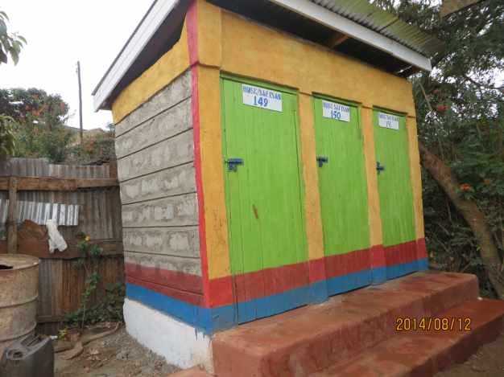
The UBSUP/SafiSan Programme

Slide 2
WSTF’s Sanitation Interventions (between 2009 and 2013)
WSTF has been involved in different interventions since 2009. These include:
Designing public sanitation concept:
Construction of public sanitation facilities in market places and bus parks
Sewer line extensions in low income urban areas
Impact:
Public sanitation facilities constructed
2. Total of about 9 kilometres of sewer line extended (pilot)
These interventions catered for the public and were more community based. There was a need for a programme that was more household and plot level oriented.

Slide 3
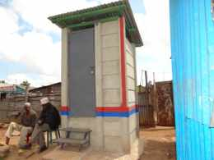

Need for Up-Scaling
Up-scaling Basic Sanitation for the Urban Poor (UBSUP) is a 6-year joint programme of WSTF & GIZ
UBSUP is financed by the German Development Bank (KfW) and the Bill & Melinda Gates Foundation (BMGF)
Overall objectives:
Improve living conditions of the urban poor
Targets populations of the urban low income areas in Kenya with dire need of better sanitation
Enable residents to practice good hygiene practices
Develop standards for replication (scaling up)
Focus on plot & household level sanitation
Focus on the sanitation value chain

Slide 4
UBSUP Programme..
Specific objectives:
Provide sustainable sanitation (better toilets) for 400,000 residents
Reach 200,000 residents with safe water (done)
Ensure safe & sustainable emptying, transport & treatment of toilet sludge
Establish a monitoring system for tracking access to safe water & basic sanitation facilities (SafisApp)
Enhance active participation in the provision of basic sanitation to the urban poor by other stakeholders (e.g. residents, Counties, NGOs)
Develop a sanitation up-scaling concept in line with the sector reforms

Slide 5
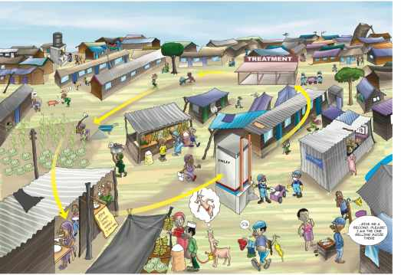
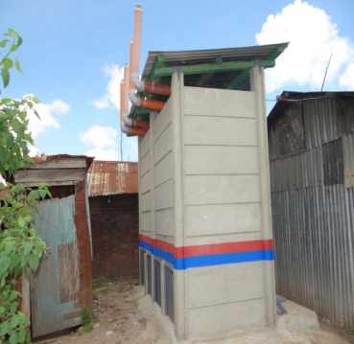
Sanitation value chain
UBSUP’s approach
Sanitation Post Construction Incentive (PCI) approach
Performance (output) based approach
Principle of full sanitation value chain
Specifically targets the population of the urban low income areas in Kenya

Slide 6

SafiSan is the name of the projects that will be incorporated in the UBSUP programme.
The term SafiSan is to assist with the branding of the toilets .
This is a national programme and the theme of up-scaling is well catered for if we have a brand name that is used all over the country to identify the sanitation interventions.
Why SafiSan?

Slide 7
Key Considerations and programme approaches
Customer aided design (affordable and easy to construct)
Targeting households and plots
Financing through Water Service Providers
Sound marketing of sanitation to create demand
Incentivized construction of the facilities
Sustainable sludge management
Targeting urban low income areas
Promotion of reuse of treated waste (sanitation value chain)

Slide 8
Key considerations and programme approaches..
Minimum standards and service levels
      The Water Sector Sanitation Concept (2009)
        Safe sanitation shall fulfill human rights requirements to sanitation and shall only be counted as sustainable access to safe sanitation if safe disposal of effluent and excreta is guaranteed
        Human rights criteria are: safe to access and use, physically accessible, affordable for the users, culturally acceptable
      National Environmental Sanitation and Hygiene Policy of 2007
        Protecting environment from pollution & negative human health effects
        Identifying appropriate technologies
      3. UBSUP Studies
        Result of study conducted in low income areas (LIAs) of 11 towns
        Analysis of the current sanitation practices in Kenya
        Feedback from the users

Slide 9
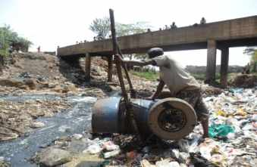
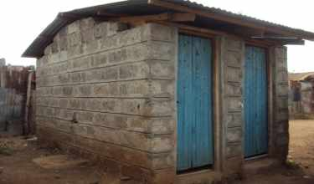
Key considerations and programme approaches..
Target group
      Those with poor sanitation facilities
        Develop appropriate safe sanitation
        facilities (dry and water based)
        Develop appropriate corresponding sludge
        management facilities
        Establish appropriate corresponding sanitation service delivery chain

Slide 10
Adapted Technical Options
1. User Interface
Water Based Toilets (Pour and Cistern flush connected to septic/conservancy tanks or existing sewers)
2. Sludge treatment
Sludge Drying Beds (secondary treatment) for water based and dry toilets
Decentralized Treatment Facilities (DTFs) for water based systems and sludge from VIPs and improved pit latrines
Dry Toilets (Urine Diverting Dry Toilets-UDDTs)
UDDT Vaults (primary treatment) for dry toilets

Slide 11
Sanitation marketing
The Sanitation Marketing aims to ensure that there is:
Systematic data collection and analysis to develop appropriate marketing strategies with changing times and circumstances
Toilet designs , emptying services and promoting behaviors that fit the felt needs of the consumers/users
Strategic approach to promoting improved sanitation, emptying services, and good hand washing behaviors is promoted
Effective methods of distribution of SafiSan toilets so that when demand is created at area, town level, consumers know where and how to get the products, services, or behaviors
Adoption of improved sanitation, emptying services, or behaviors and increasing the willingness of consumers/users to contribute something in exchange for improved sanitation
Cost effective Pricing so that the product or service is affordable

Slide 12
UBSUP Funding
What does the WSTF fund?
Awareness programme
Sanitation marketing programme & materials including sanitation marketers
Training of sanitation teams & exhausters
Construction of DTFs
Training of DTF operators
DTF operation package ( Office)
Branding & certification of WSP infrastructure & operators/emptiers
Post Construction Incentive for toilets
What does WSTF not fund?
Acquisition of sites (DTFs, drying beds)
Operation of decentralized treatment facilities

Slide 13
WSTF Challenges
Sanitation is not always a priority for households or for government officials
Institutional transformation is weak
Lack of awareness of the real and perceived difficulties
Lack of attention to O & M of critical sanitation options like dry onsite sanitation options
Regulatory framework is weak, does not encourage and support private initiatives in the provision of sanitation services
Informal areas growing faster than sanitation service provision and available solutions

Slide 14
WSTF Challenges..
Land issues at the poor and informal communities
Development of sound and sustainable up-scaling concepts usually takes time
Limited technical options for varying sanitation needs and user preferences
Lack of clear incentives to the WSPs to motivate them into supporting the programme (most WSPs prefer sewerage to on-site sanitation)
Sanitation has low priority among the low income population delaying roll out
Existing policies on sanitation

Slide 15
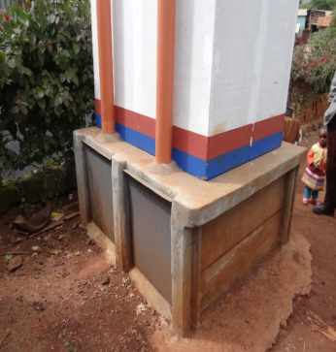
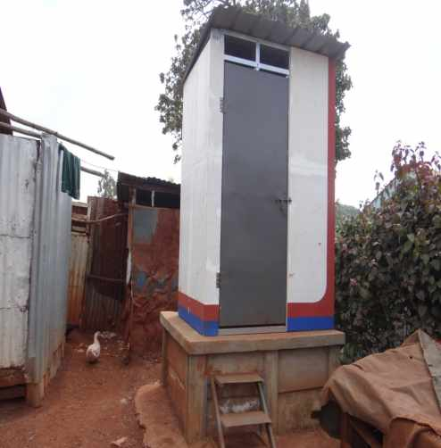
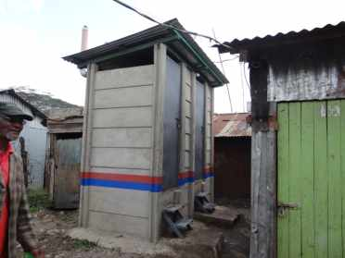
THANK YOU!!!

